Slide 1
K-Means Clustering
What it is?
python implementation
Use cases
Kumar Sundram

Slide 2
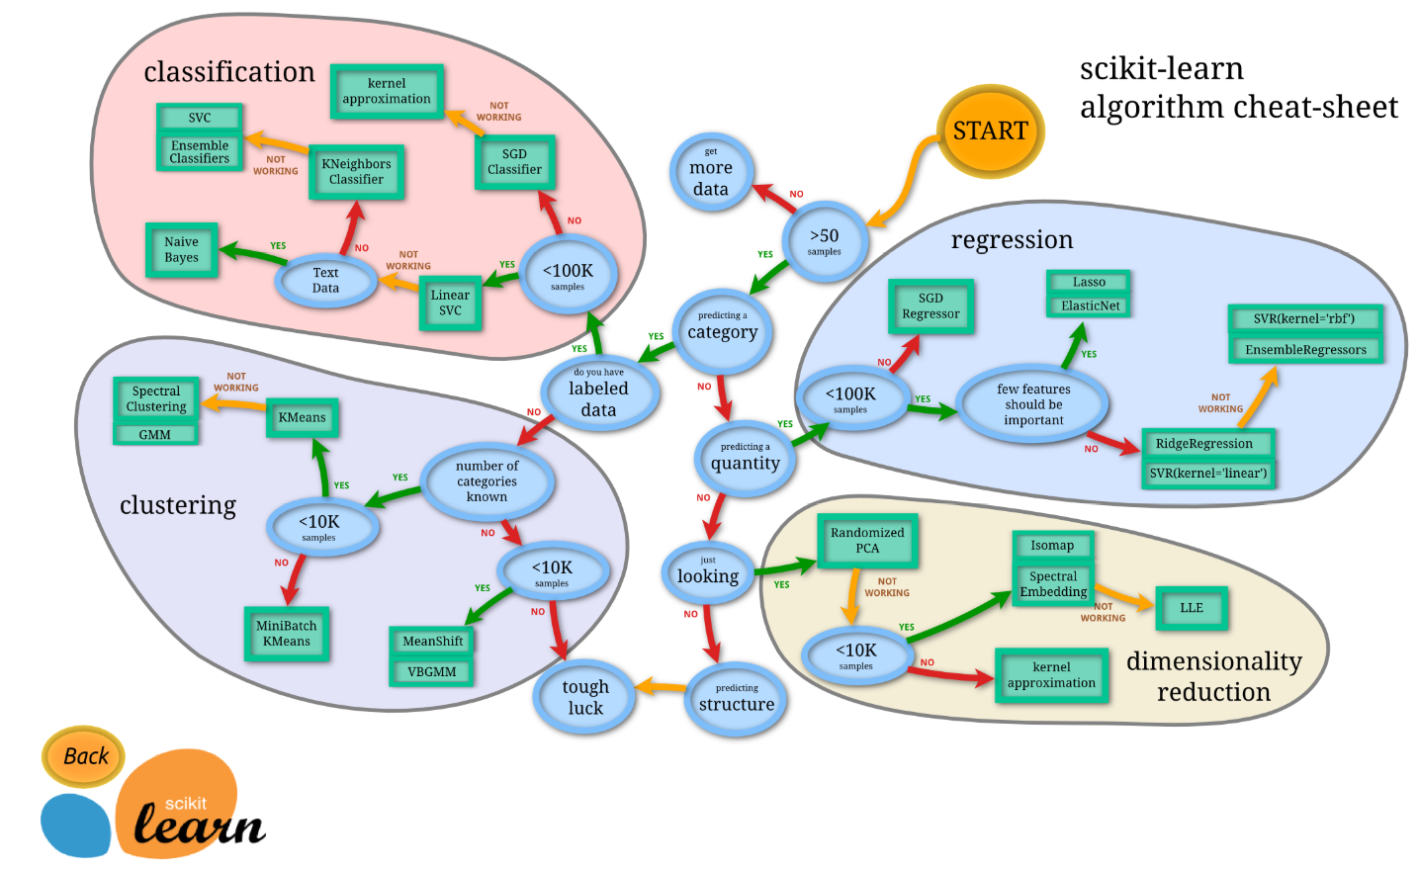
Scikit-learn – cheat sheet

Slide 3
What it is
K-means clustering is a simple unsupervised learning algorithm that is used to group/ cluster n objects based on certain attributes into k partitions, where k < n.
Follows a simple procedure of classifying a given data set into a number of clusters, defined by the letter "k," which is fixed beforehand.
Groups data using a “top-down” approach since it starts with a predefined number of clusters and assigns all observations to each of them.
no overlaps in the groups; each observation is assigned only to a single group.
Approach is computationally faster and can handle greater numbers of observations than agglomerative hierarchical clustering
K-means clustering has uses in search engines, market segmentation, statistics and even astronomy.

Slide 4
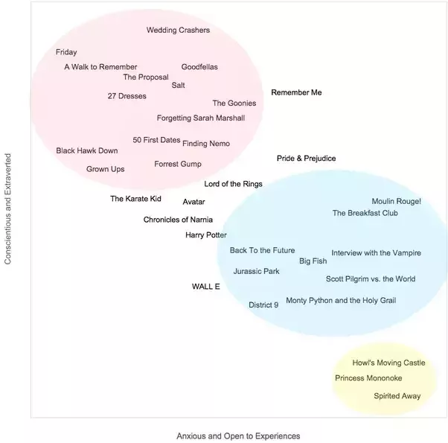
Example
Different movie genres appeal to people of different personalities. To confirm this, construct a plot of movie titles along personality dimensions:
There appears to be 3 clusters:
Red: Conscientious extraverts who like action and romance genres
Blue: Anxious and open people who like advant-garde and fantasy genres
Yellow: Introverts with social anxieties who like Japanese animations (otaku culture)
Movies in the center seem to be general household favorites.

Slide 5
K-Means Algorithm Properties
There are always K clusters.
There is always at least one item in each cluster.
The clusters are non-hierarchical and they do not overlap.
Every member of a cluster is closer to its cluster than any other cluster

Slide 6
The K-Means Algorithm Process
The dataset is partitioned into K clusters and the data points are randomly assigned to the clusters.
For each data point:
Calculate the distance from the data point to each cluster.
If the data point is closest to its own cluster, leave it where it is. If the data point is not closest to its own cluster, move it into the closest cluster.
Repeat the above step until a complete pass through all the data points results in no data point moving from one cluster to another. At this point the clusters are stable and the clustering process ends.
The choice of initial partition can greatly affect the final clusters that result, in terms of inter-cluster and intra-cluster distances

Slide 7
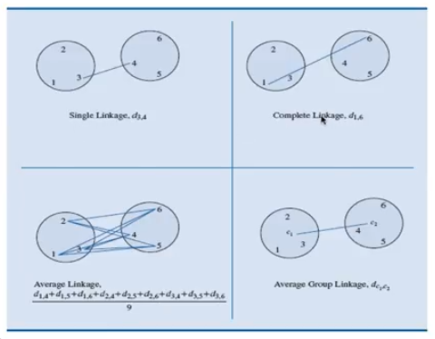
Proximity between clusters
Single Linkage - Distance between two nearest patterns in the clusters
Complete Linkage - Distance between 2 farthest data patterns
Average Linkage –
Average Group (centroid) linkage –

Slide 8

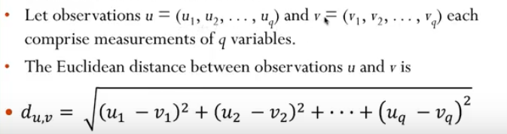
Distance calculation
The Euclidean distance function measures the ‘as-the-crow-flies’ distance. The formula for this distance between a point X (X1, X2, etc.) and a point Y (Y1, Y2, etc.) is:

Slide 9
How it works
Group the data points into 3 clusters
Randomly decide on starting center points of the 3 clusters

Slide 10
How it works
Initial centroid assigned (randomly)
Distance calculation using rectilinear method and assignment of cluster based on min distance
New centroid for each cluster calculated (averaging of data points)

Slide 11
How it works
Centroid adjusted from previous iteration
Distance calculation using rectilinear method and assignment of cluster based on min distance
New centroid for each cluster calculated (averaging of data points)

Slide 12
How it works
Centroid adjusted from previous iteration
Distance calculation using rectilinear method and assignment of cluster based on min distance
No change in the cluster assignment, Hence STOP
New centroid for each cluster calculated (averaging of data points)

Slide 13
Kmeans visualization
http://shabal.in/visuals/kmeans/4.html

Slide 14
Practical Applications
Customer Segmentation:
Pricing Segmentation
Loyalty
Spend Behaviour
Branch Geo
Customer Need | needs, channel of preferences, service expectations.
Category | Who are these customers? Why are they behaving the way to?
Customer Service | Customer Value in last 6/12/18/24 months Customer Type – Individuals and Small Businesses Product type (e.g. Gas, Electricity etc) Length of Relationship Overall consumption Number of complains
News Article Clustering

Slide 15
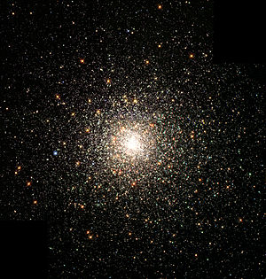
Disadvantages
Fixed number of clusters can make it difficult to predict what K should be.
Does not work well with non-globular clusters.
Different initial partitions can result in different final clusters.
Even outliers become part of some cluster!
A Globular clusters are very tightly bound, which gives them their spherical shapes and relatively high stellar densities toward their centers.

Slide 16
When K-Means Clustering Fails
(-) Real-life data is almost always messy.
(-) The examples and illustrations we see in our statistics courses are designed to reflect ideal situations that sadly almost never occur in the real world.
(+) This works best when your data is roughly "spherical," as in the toy data set
(+) Still the most widely used unsupervised machine learning algorithms

Slide 17
Use cases
Behavioral segmentation | Inventory categorization | Sorting sensor measurements | Detecting bots or anomalies
Segment by purchase history Segment by activities on application, website, or platform Define personas based on interests Create profiles based on activity monitoring | Group inventory by sales activity Group inventory by manufacturing metrics | Detect activity types in motion sensors Group images Separate audio Identify groups in health monitoring | Separate valid activity groups from bots Group valid activity to clean up outlier detection

Slide 18
Kmeans – scitkit learn
KMeans(n_clusters=8, init=’k-means++’, n_init=10, max_iter=300, tol=0.0001, precompute_distances=’auto’, verbose=0, random_state=None, copy_x=True, n_jobs=None, algorithm=’auto’)[source]
Attributes:
cluster_centers_ : array, [n_clusters, n_features] Coordinates of cluster centers. If the algorithm stops before fully converging
labels_ : Labels of each point
inertia_ : float, Sum of squared distances of samples to their closest cluster center.
n_iter_ : int, Number of iterations run.

Slide 19
K-means++
How does the k-means++ works?
research yourself!!!
Essentially there are 3 methods to assign initial centers
K-Means++
Random choice of points from the samples
user provided points(vectors)
K-Means++
Say we need to select 2 cluster centers,
instead of selecting them all randomly {like we do in simple k means}, we will select the first one randomly, then find the points that are farthest to the first center
These points most probably do not belong to the first cluster center as they are far from it and assign the second cluster center nearby those far points.

Slide 20
Specifying different distance calculation method
SCITKIT learn implementation only supports ‘Euclidean’ distance measure

